Slide 1
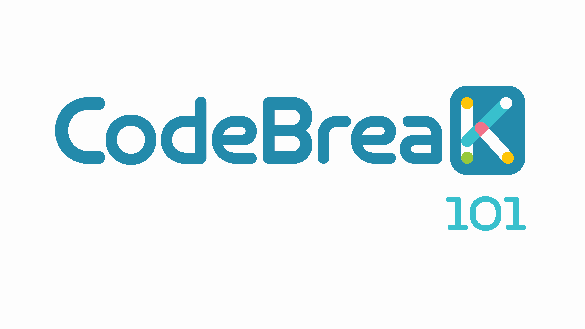
Sotorasib in Combination with RMC-4630, a SHP2 Inhibitor, in KRAS p.G12C-Mutated NSCLC and Other Solid Tumors
Gerald S. Falchook,¹ Bob T. Li,² Kristen A. Marrone,³ Christine M. Bestvina,⁴ Corey J. Langer,⁵
John C. Krauss,⁶ John H. Strickler,⁷ Alison R. Meloni,⁸ Tian Dai,⁸ Tracy L. Varrieur,⁸ David S. Hong⁹
¹Sarah Cannon Research Institute at HealthONE, Denver, CO, USA; ²Memorial Sloan Kettering Cancer Center, Weill Cornell Medicine, New York, NY, USA; ³Johns Hopkins School of Medicine, Baltimore, MD, USA; ⁴University of Chicago Medicine, Chicago, IL, USA; ⁵Perelman Center for Advanced Medicine, Philadelphia, PA, USA; ⁶University of Michigan Medical School, Ann Arbor, MI, USA; ⁷Duke University Medical Center, Durham, NC, USA; ⁸Amgen Inc., Thousand Oaks, CA, USA; ⁹The University of Texas MD Anderson Cancer Center, Houston, TX, USA
Presented at World Conference on Lung Cancer (WCLC) 2022 Annual Meeting, August 6-9, 2022; Vienna, Austria.
SC-AT-AMG 510-00189 0822

Slide 2
Diese Präsentation ist urheberechtlich geschützt durch Amgen GmbH. Amgen GmbH stellt dieses Präsentationsmaterial für Angehörige des medizinischen Fachkreises mit Zugang zur Oncology Horizons Webseite zur Verfügung. Es dient ausschließlich zur eigenen Verwendung und darf nicht an Dritte weitergeleitet werden. Es dürfen keine inhaltlichen Änderungen vorgenommen werden.
SC-AT-NP-00098 06.21

Slide 3
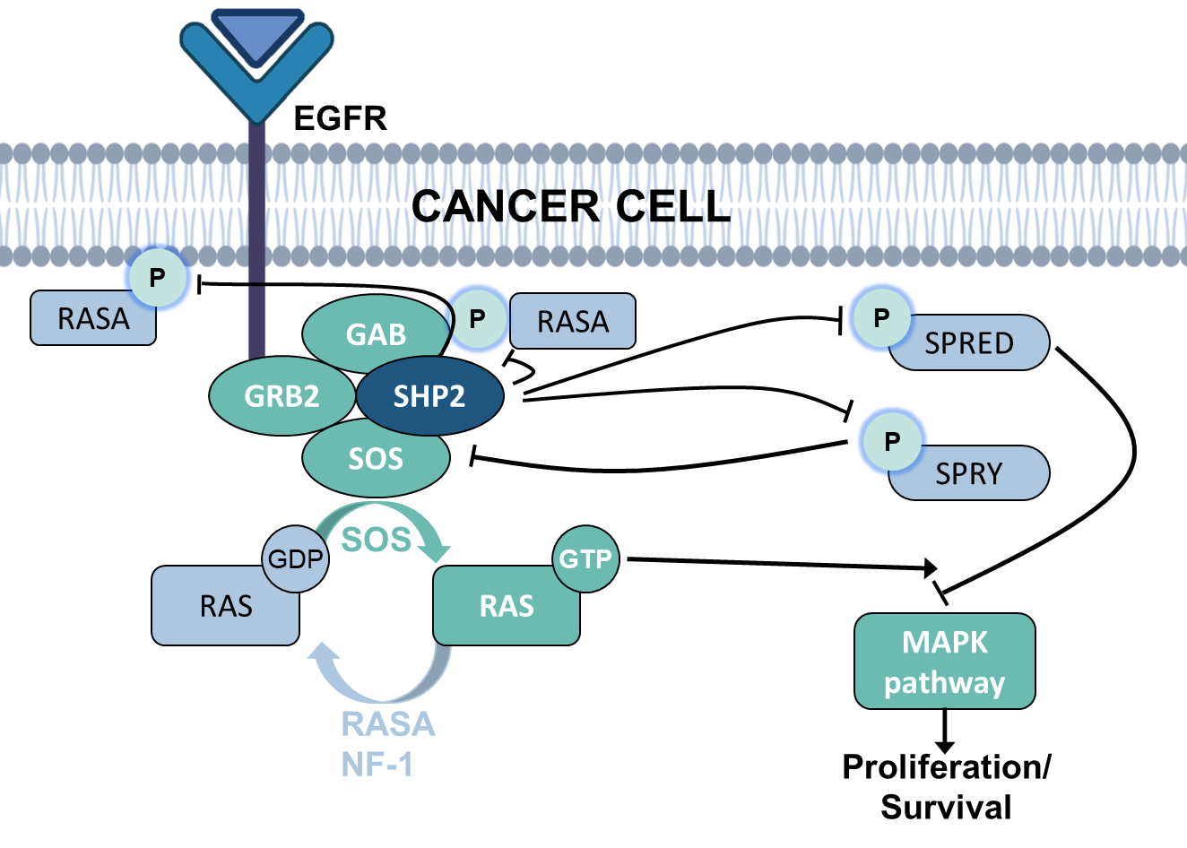
Background and Objectives
    Sotorasib, a specific and irreversible KRAS^{G12C} inhibitor, is approved in the US and other countries for patients with previously treated KRAS G12C-mutated NSCLC¹⁻³
    Genomic alterations in the RTK pathway have been identified as a putative mechanism of resistance to sotorasib⁴
    In mouse xenograft models, combining sotorasib with a SHP2 inhibitor (SHP2i) impaired RTK signaling to RAS and enhanced anti-tumor efficacy^{5,6}
This study evaluated the safety and efficacy of sotorasib combined with RMC-4630, a small molecule SHP2i; herein, we present results, with a focus on patients with NSCLC
KRAS, Kirsten rat sarcoma viral oncogene homolog; NSCLC, non-small cell lung cancer; RAS, rat sarcoma virus; RTK, receptor tyrosine kinase; SHP2i, Src homology region 2 domain-containing phosphatase-2 inhibitor.
Falchook GS, et al. Presented at World Conference on Lung Cancer (WCLC) 2022 Annual Meeting, August 6-9, 2022; Vienna, Austria.

Slide 4
Study Design: Sotorasib + SHP2 Inhibitor (RMC-4630)
Phase 1b multicenter, open-label study (NCT04185883); data cutoff: April 11, 2022
Screening/Enrollment
PART 1: Dose Exploration
(N = 27)
Key eligibility criteria*
Locally advanced or metastatic KRAS G12C solid tumors
Prior anti-PD-(L)1 and/or platinum-based chemotherapy and targeted therapy (NSCLC)
Allowed prior KRAS^{G12C} inhibitor
Sotorasib (960 mg PO daily) + RMC-4630 (PO) at:
200 mg at days 1 and 2 Q7D
140 mg at days 1 and 2 Q7D
100 mg starting dose at days 1 and 2 or days 1 and 4 Q7D
Primary endpoints: Safety
Dose-limiting toxicities
TRAEs and TEAEs
Changes in vital signs, ECGs, and clinical laboratory tests
Secondary endpoints
Pharmacokinetics
ORR, DOR, TTR, PFS, DCR, duration of stable disease per RECIST v1.1, OS
*Prior systemic therapy for advanced/metastatic disease (other tumor types).
DCR, disease control rate; DOR, duration of response; ECG, electrocardiogram; KRAS, Kirsten rat sarcoma viral oncogene homolog; ORR, objective response rate; OS, overall survival; PD-(L)1, programmed death-(ligand) 1; PFS, progression-free survival; PO, per oral; Q7D, every 7 days; RECIST, Response Evaluation Criteria in Solid Tumors; SHP2, Src homology region 2 domain-containing phosphatase-2; TEAE, Treatment-emergent adverse event; TRAE, treatment-related adverse event; TTR, time to response.
Falchook GS, et al. Presented at World Conference on Lung Cancer (WCLC) 2022 Annual Meeting, August 6-9, 2022; Vienna, Austria.

Slide 5
Baseline Characteristics
 | NSCLC (N=11) | Total (all tumors)* (N=27)
Median age, years (range) | 64 (51–78) | 63 (43–78)
Male, n (%) | 4 (36) | 15 (56)
Smoking history, n (%)† | 11 (100) | 19 (70)
ECOG performance score, n (%)
0 | 10 (90) | 5 (19)
1‡ | 0 | 20 (74)
Brain metastasis, n (%) | 7 (64) | 13 (48)
Liver metastasis, n (%) | 3 (27) | 11 (41)
Median lines of prior therapies, n (range) | 3 (1–6) | 3 (1–6)
Prior KRAS^{G12C} inhibitor, n (%)§ | 5 (45) | 11 (41)
Prior anti-PD-(L)1, n (%) | 10 (91) | 15 (56)
*Total cohort includes patients with NSCLC (n = 11; 41%), colorectal cancer (n = 9; 33%), and other solid tumors (n = 7; 26%).
†Includes former and current smoking history.
‡One patient with NSCLC had a change in ECOG-PS from 1 to 2 during screening, and one patient with missing entry.
§Includes 8 patients treated with sotorasib and 3 patients treated with adagrasib.
ECOG-PS, Eastern Cooperative Oncology Group Performance Score; KRAS, Kirsten rat sarcoma viral oncogene homolog, NSCLC, non-small cell lung cancer; PD-(L)1, programmed death-(ligand) 1.
Falchook GS, et al. Presented at World Conference on Lung Cancer (WCLC) 2022 Annual Meeting, August 6-9, 2022; Vienna, Austria.

Slide 6
Most Common Treatment-Related Adverse Events (TRAEs)
Variable, n (%) | Sotorasib + RMC-4630 (N = 27)*
 | Related to Sotorasib |  | Related to RMC-4630 |  | Related to Sotorasib + RMC-4630
 | All Grades | Grade 3 | All Grades | Grade 3 | All Grades | Grade 3
Total TRAE | 15 (56) | 6 (22) | 17 (63) | 6 (22) | 17 (63) | 6 (22)
Edema† | 7 (26) | 0 | 6 (22) | 0 | 8 (30) | 0
Diarrhea | 7 (26) | 2 (7) | 5 (19) | 2 (7) | 7 (26) | 2 (7)
Dry mouth | 3 (11) | 0 | 2 (7) | 0 | 3 (11) | 0
Fatigue | 3 (11) | 0 | 3 (11) | 0 | 3 (11) | 0
AST increased | 1 (4) | 1 (4) | 2 (7) | 1 (4) | 2 (7) | 1 (4)
Ascites | 1 (4) | 1 (4) | 1 (4) | 1 (4) | 1 (4) | 1 (4)
Colitis | 1 (4) | 1 (4) | 1 (4) | 1 (4) | 1 (4) | 1 (4)
Dyspnea | 1 (4) | 1 (4) | 1 (4) | 1 (4) | 1 (4) | 1 (4)
Hypertension | 0 | 0 | 1 (4) | 1 (4) | 1 (4) | 1 (4)
Pleural effusion | 0 | 0 | 1 (4) | 1 (4) | 1 (4) | 1 (4)
TRAEs consistent with known safety profile of sotorasib and RMC-4630 Edemas (peripheral and facial) were most common TRAE; all were Grade 1 or 2, and none led to discontinuation
*Related to either study drug across all doses. Includes TRAEs with > 10% patient incidence across all grades and all grade ≥ 3 TRAEs; no Grade 4 or 5 TRAEs were reported.
†Includes general, peripheral, periorbital, and facial edema.
AST, aspartate aminotransferase.
Falchook GS, et al. Presented at World Conference on Lung Cancer (WCLC) 2022 Annual Meeting, August 6-9, 2022; Vienna, Austria.

Slide 7
TRAEs
Variable*, n (%) | Sotorasib 960 mg + RMC-4630 100 mg (N = 6) | Sotorasib 960 mg + RMC-4630 140 mg (N = 10) | Sotorasib 960 mg + RMC-4630 200 mg (N = 11)
TRAE any grade | 6 (100) | 4 (40) | 7 (64)
Grade 3 | 1 (17) | 1 (10) | 4 (36)
TRAE leading to sotorasib dose modification† | 1 (17) | 1 (10) | 3 (27)
TRAE leading to RMC-4630 dose modification† | 2 (33) | 1 (10) | 4 (36)
TRAE leading to sotorasib discontinuation‡ | 1 (17) | 0 | 0
TRAE leading to RMC-4630 discontinuation‡§ | 1 (17) | 1 (10) | 1 (9)
Number of patients with a dose limiting toxicity¶ | 1 | 1 | 0
Sotorasib combined with RMC-4630 was safe and tolerable, with no Grade 4 or fatal TRAEs
*Related to either study drug.
†Patients dose reduced or interrupted both drugs for increased ALT, diarrhea, pleural effusion, colitis, fatigue (1 each); sotorasib only for diarrhea, increased AST, dry mouth, dyspnea (1 each);
RMC-4630 only for peripheral edema, ascites, hypertension, constipation, liver function test increased (1 each).
‡One patient had increase in AST leading to discontinuation of both RMC-4630 and sotorasib.
§One patient had diarrhea and one patient had ascites leading to RMC-4630 discontinuation.
¶Patient experienced grade 3 AST elevation at 100 mg RMC-4630 and grade 3 ascites at 140 mg RMC-4630.
ALT, alanine aminotransferase; AST, aspartate aminotransferase; TRAE, treatment-related adverse event.
Falchook GS, et al. Presented at World Conference on Lung Cancer (WCLC) 2022 Annual Meeting, August 6-9, 2022; Vienna, Austria.

Slide 8
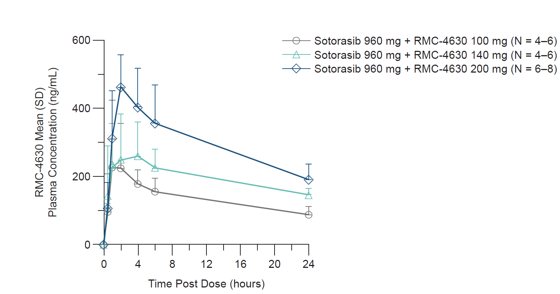
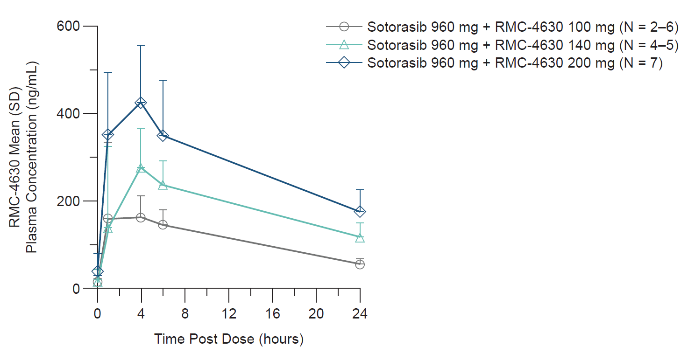
Treatment Exposure
    Duration on combination treatment (mean [SD]): 3.1 (2.7) months
    Average sotorasib and RMC-4630 exposures consistent with distributions observed in monotherapy studies
Day 1
Day 8
There were no clinically meaningful drug-drug interactions between sotorasib and RMC-4630
Falchook GS, et al. Presented at World Conference on Lung Cancer (WCLC) 2022 Annual Meeting, August 6-9, 2022; Vienna, Austria.

Slide 9
Efficacy*
Response assessed by investigator | NSCLC
 | All enrolled (N = 11) | KRAS^{G12C} inhibitor-naïve (N = 6)
ORR, % (95% CI) | 27 (6, 61) | 50 (12, 88)
Best overall response, n (%)
Partial response | 3 (27) | 3 (50)
Stable disease | 4 (36) | 3 (50)
Progressive disease | 4 (36) | 0
Disease control rate, n (%) | 7 (64) | 6 (100)
Other tumor types: 8 CRC (5 SD; 3 PD); 1 ovarian cancer (PR with an 81% reduction in tumor burden); 1 pancreatic adenocarcinoma (SD), and 2 other solid tumors (1 SD, 1 NE).
Disease control in 7 of 11 patients with NSCLC and in all patients who were KRAS^{G12C} i-naïve Promising early efficacy observed in patients with NSCLC who were KRAS^{G12C} i-naïve
*Efficacy is summarized only for evaluable patients who were treated and had the opportunity for at least 1 post-baseline scan.
CRC, colorectal cancer; i, inhibitor; KRAS, Kirsten rat sarcoma viral oncogene homolog; NE, non-evaluable; NSCLC, non-small cell lung cancer; ORR, objective response rate; PD, progressive disease; PR, partial response; SD, stable disease.
Falchook GS, et al. Presented at World Conference on Lung Cancer (WCLC) 2022 Annual Meeting, August 6-9, 2022; Vienna, Austria.
Notes:
WCLC Soto_SHP2i Combo abstract_3.11.22_Final_edited: 1-A-3|

Slide 10
Tumor Response* in NSCLC
*One patient with PD was not included in tumor response due to data entry error.
At the two highest doses, responders included 3 of 4 patients who were KRAS^{G12C} i-naïve
i, inhibitor; KRAS, Kirsten rat sarcoma viral oncogene homolog; NSCLC, non-small cell lung cancer; PD, progressive disease; PR, partial response; SD, stable disease.
Falchook GS, et al. Presented at World Conference on Lung Cancer (WCLC) 2022 Annual Meeting, August 6-9, 2022; Vienna, Austria.

Slide 11
Treatment Duration in NSCLC
    Median follow-up: 5.8 months
Two of 3 patients with PR had an ongoing response at data cutoff One patient, whose NSCLC progressed on prior sotorasib, achieved tumor shrinkage > 30% at 5.5 months, with PD at 6.9 months
DOR, duration of response; KRAS, Kirsten rat sarcoma viral oncogene homolog; NSCLC, non-small cell lung cancer; PD, progressive disease; PR, partial response; SD, stable disease.
Falchook GS, et al. Presented at World Conference on Lung Cancer (WCLC) 2022 Annual Meeting, August 6-9, 2022; Vienna, Austria.

Slide 12
Conclusions
Preclinical rationale and putative mechanisms of resistance support the combination of sotorasib with a SHP2 inhibitor
Combination of sotorasib with a SHP2 inhibitor, RMC-4630, based on early data, appears safe and well-tolerated in KRAS G12C-mutated solid tumors
    There were no Grade 4 or fatal TRAEs and few TRAE-related discontinuations
Promising and durable clinical activity was observed in patients with NSCLC, most notably in those who were KRAS^{G12C} inhibitor-naïve
A study is underway (NCT05054725) to further define efficacy and safety of this combination in patients with mNSCLC who are KRAS^{G12C} inhibitor-naïve (WCLC 2022 e-poster #EP08.02-111)
KRAS, Kirsten rat sarcoma viral oncogene homolog; mNSCLC, metastatic non-small cell lung cancer; SHP2, Src homology region 2 domain-containing phosphatase-2; TRAE, treatment-related adverse event.
Falchook GS, et al. Presented at World Conference on Lung Cancer (WCLC) 2022 Annual Meeting, August 6-9, 2022; Vienna, Austria.

Slide 13
Acknowledgements
The authors thank the patients and their families, clinical trial staff, and the study teams for contributing to this trial
Amgen Inc. funded this study; pharmacokinetic analysis was performed by Panli Cardona (Amgen Inc.), and medical writing support was provided by Lisa Denny (ICON plc, Blue Bell, PA, USA) funded by Amgen Inc. The abstract and presentation were reviewed by and RMC-4630 was supplied by Revolution Medicines, in collaboration with Sanofi.
References
LUMAKRAS® (sotorasib). Prescribing Information. Thousand Oaks, CA, Amgen Inc., 2021.
LUMYKRAS® (sotorasib). Summary of Product Characteristics, Cambridge, UK, Amgen Ltd., 2021.
LUMYKRAS® (sotorasib). European Medicines Agency. Available at https://www.ema.europa.eu/en/medicines/human/EPAR/lumykras. Accessed May 24, 2022.
Li BT, et al. J Clin Oncol. 2022;50(36 suppl):Abstract #360490.
Rex K, et al. Cancer Res. 2021;81(13 suppl):Abstract #1057.
Smith JAM, et al. Cancer Res. 2020;80(16 suppl):Abstract #1943.
LUMAKRAS® and LUMYKRAS® are registered trademarks of Amgen Inc.
Falchook GS, et al. Presented at World Conference on Lung Cancer (WCLC) 2022 Annual Meeting, August 6-9, 2022; Vienna, Austria.

